Slide 1
Global energy arbitration Centre, new DELHI Timely resolution for energy revolution BY DR. GOPAL ENERGY FOUNDATION, new delhi (www.dgef.in)

Slide 2
What is GEAC?
GEAC stands for Global Energy Arbitration Centre and is the modified name of IEAC. The IEAC was established by DGEF vide resolution dated 8th June, 2016 and modified vide resolution dated 4th January, 2022.
It provides mechanisms such as Arbitration, Conciliation, Mediation and also provides services such as suitable venues, secretarial assistance, reference documents, forums for discussions, training to become arbitrators to all stakeholders in the energy sector.
Serving energy sector like Power/Petroleum & Energy Gas/ New & Renewable Energy/ Coal/ E-mobility/ Nuclear Energy/Energy storage etc including National & Other International Investments.
GEAC facilitates speedy and quick decisions and resolution of disputes.

Slide 3
Release of IEAC Rules, 2019
Release of IEAC Rules on 15.04.2019 during TICE-4, Delhi

Slide 4
Renaming Of IEAC To GEAC during TIMCEE-2, 2019

Slide 5
Services provided
Arbitration
Conciliation
Mediation
Secretarial Assistance (Online/Offline)
Venue for Arbitration
Reference Documents
Forum for Discussions
Training to become arbitrators

Slide 6
Online Arbitration for Energy Sector
GEAC is a Leading Online Arbitration Centre.
State of the Art ADR Infrastructure.
Hybrid communication model through online & physical Conferences between Tribunal and Parties.

Slide 7
Why was GEAC/IEAC created
The exponential growth of Power sector and huge financial investment has led to the rapid growth of disputes between Developers/ Owner and Contractors/ Suppliers/ Consultants. By now thousands and thousands of cases are pending in Arbitration Tribunals/Courts.
Further the International Solar Alliance has committed one trillion dollars as investment by 2030, the alliance will support India in achieving its goal of generating 175 GW of renewable energy by 2022 which includes 100 GW of solar energy.
During COP- 26, Government of India has further increased its renewable energy target and committed for producing 500 GW of Renewable energy by 2030.
Electricity Act,2003 of India provides for arbitration in terms of Section 158 and 79(f).
According to World Bank’s report of 2018 it would take more than 1400 days for a company to resolve a commercial dispute through a local first instance court.
This reason compelled DGEF to initiate action and establish the Arbitration Centre.

Slide 8
Objective
Determination, settlement and adjudication of disputes and differences relating to power, petroleum & energy gas, new & renewable energy, coal and nuclear energy.
International disputes relating to energy investments in India etc inter alia energy sector, arising between parties in India or a party in India and a party in a foreign country, who agree or have agreed in writing to submit such disputes and differences for arbitration under the Rules of the Tribunal.

Slide 9
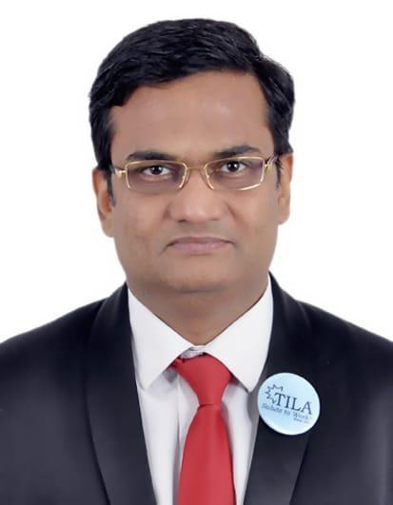
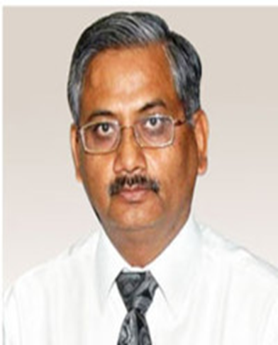
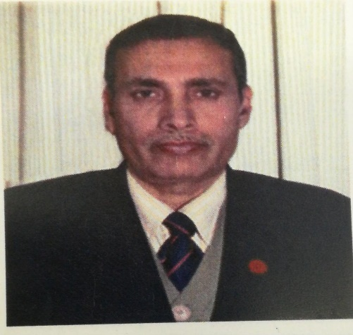
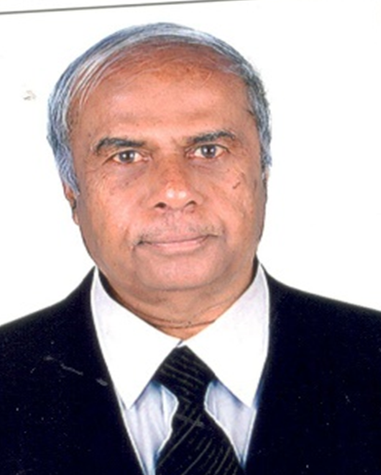
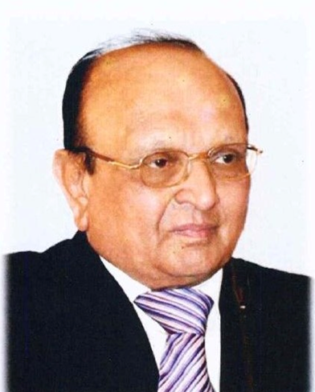
The Board of Governors
Mr. Raj Singh Niranjan, Managing Partner, TILA.
Mr. ABL Srivastava Former CMD, NHPC
Dr. G.P. Patel , President DGEF
Mr. K. Sudheendra Former Chief Engineer, KPCL
Mr. Pranav R. Mehta Chairman, Global Solar Council

Slide 10
Who can join Centre?
Corporate Members
Individual Members
Students
Contractors/Suppliers/ Consultants/ Traders
Arbitrators

Slide 11
Eligibility for Joining Centre
Particulars | Corporate Members | Arbitrators | Individual Members/ Contractors | Junior Members/ Students
Forms | Form I | Form III | Form IV | Form V
Eligibility | Company registered under companies act and working under the Power/Petroleum & Energy Gas/ New & Renewable Energy/ Coal/ E-mobility/ Nuclear Energy/Energy storage/Other International Investments in energy sectors. | Arbitrators with relevant experience in the field of energy sector . | Any individual who is 21 years and above and is a graduate in any discipline, interested. | Any individual who is 18 years and above and bonafide student of Engineering/ Management/Law, who is interested in Energy Arbitration

Slide 12
Eligibility for becoming an Arbitrator in GEAC?
One can join as an arbitrator only by invitation. Following can be an arbitrator:
Judges- Honorably retired as Judges of the Supreme Court or, any of the High Courts or, members of Central Regulatory Commission /State Regulatory Commission or, Appellate Tribunal of Electricity who have made pronouncements in cases related to energy disputes.
Professionals (Adv/ CA /CS/ Valuer/ CWA)- Lawyers at least at the level of the High Court for at least ten years; experience in arbitration matters and knowledge of energy laws and also of Arbitration Law & Procedure required for all categories.
Businessman- Company directors and other persons with outstanding reputation with at least ten years of work experience in the Energy Sector as well as experience in Arbitration Law & Procedure.

Slide 13
Experts of Govt/PSU- Those who have served as Executive Director and above in Energy Companies and those who have also served as Joint Secretary in Central or, State Government Energy related departments with experience in Arbitration Law & Procedure.
Foreign Nationals- Suitable persons of nationalities other than Indian resident in India or abroad who have adequate knowledge and at least ten years experience in commercial and arbitration procedures.
Other Specialists- Suitable persons not included in the above categories having 15 years of experience in the specialized areas of energy sector and with at least ten years of experience in the Arbitration Law & Procedure.

Slide 14
Privileges
Corporate Members Services of experienced & capable arbitrators Administrative services Access to status of the matter Online services at no extra cost Options to opt for up to 3 arbitrators Resolution of international conflicts Membership benefits upto 2 members Legal & technical assistance Facilitates hearings in the GEAC office & in other locations 3 MONTH online TRAINING to Nodal officers nominated by Corporate members through Energy Arbitration Online certificate Course awarded by DGEF | Individual Members/ lifetime members Receive advance notice & special concessions to attend our events Become a member in our online membership directory Receive invites for our international events Gain experience, being the member of international arbitrations Training Programmes 3 MONTH TRAINING- Energy Arbitration Online certificate Course awarded by DGEF. Opportunity to observe TILA International Moot Court Competitions. | Arbitrators Opportunity to resolve energy disputes Claim based incentives Option to work through Online or Offline mode Brings you the latest legal position & news Secretarial Assistance Access to online legal library ORIENTATION- Energy Arbitration Online certificate Course awarded by DGEF. Oppurtunity to become Judges in TILA Moot Court Competitions. | Junior members/Students Receive advance notice & special concessions to attend our events Become a member in our online membership directory A great practical learning experience. An opportunity to work on various arbitration matters and awarded certificates on completion of various tasks assigned to them. Become GEAC ambassador for your institution. Opportunity to observe TILA International Moot Court Competitions.

Slide 15
Fee for Centre Membership
Form | CATEGORY | FEES
1. | For life time/ Permanent individual membership | INR 19000/- | 250 USD
2. | For individual annual membership | INR 1900/- Per Annum | 25 USD
3. | For empanelment as Arbitrator | INR 19000/-for 10 years | 250 USD
4. | For lifetime Corporate Membership | INR 80,000/- Per Annum | 1100 USD
5. | For Annual Corporate Membership | INR 8,000/- Per Annum | 110 USD
6. | For Junior Membership form (Student) | INR 1500/- Per Annum | 20 USD
*The contribution received will be used for maintaining the arbitration center and for providing facilities for speedy, fair & impartial resolution of disputes in energy sector without causing unnecessary delay or expense.

Slide 16
How to pay?
S.No. | MODE OF PAYMENTS | DETAILS
1. | BY RTGS/NEFT/ BY INTERNATIONAL TRANSFER | Dr. Gopal Energy Foundation, A/c No. 50200021957252, HDFC Bank, Branch Address- PLOT NO.-9, H & J BLOCK, LOCAL SHOPPING CENTRE, SARITA VIHAR, NEW DELHI-110076, MICR Code-110240072, IFSC Code- HDFC0000480, Swift Code-HDFCINBBDEL
2. | BY ECS/CASH DEPOSIT | Deposit cash at any Branch of HDFC across the India in favor of:-Dr. Gopal Energy Foundation, A/c No. 50200021957252
3. | BY DEMAND DRAFT/CHEQUE | The payment (Cheque / DD) should be drawn in favour of Dr. Gopal Energy Foundation, payable at New Delhi.
4. | BY CREDIT CARD/ DEBIT CARD | Swapping Machine Available at New Delhi Office- Dr. Gopal Energy Foundation, JA-121, 1st Floor, DLF Tower-A, Jasola District Centre, New Delhi-110025
6. | BY PAYMENTS GATEWAY | Pay online through link-http://www.dgef.in/payment

Slide 17
Your contribution will support Right to Energy Movement
What is Right to Energy Movement ?
Recognizing that after food, water and shelter, the 4th element of basic necessity is energy, it is a basic human right and a key indicator of development in the society.
With more than one billion brothers & sisters deprived of electricity and more than 3 billion having no access to clean fuel and technology along with 3 billion people dying each year leaving women and children helpless, there is a need to curb the widespread energy poverty across the world.
This shall be the initiation to further develop numerous yet consolidated policies for energy sector development in the society and promotion of renewable energy. This shall also promote e-mobility and electronic cooking, which is becoming a necessity considered the decreasing source of non-renewable energy in the world.
Thank you and we seek your support to make Right to Energy a Fundamental Right in all the Constitutions of the world and include it in the Universal Declaration of Human Right as a basic Human Right.(https://www.dgef.in/right-to-energy)

Slide 18
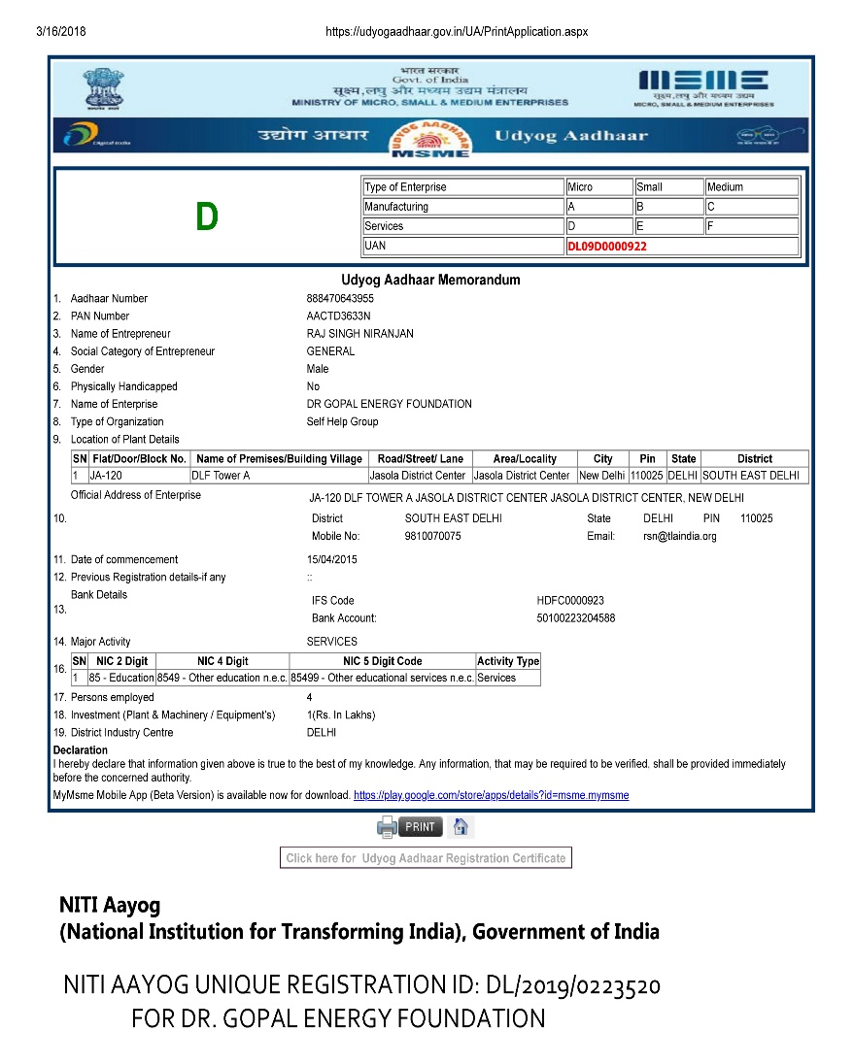
Recognition

Slide 19
Join GEAC Today!
We encourage Experts from Energy sector & Legal Sectors to get empanelled as arbitrators with GEAC. This can be done by
By Online registration at www.dgef.com, or
By sharing filled in form on WhatsApp 9810070075, or
By Share filled in form by e-mail to registrar@dgef.in

Slide 20
For more information, please contact:
WhatsApp +91 9810070075 Email – registrar@dgef.in
Dr. Gopal Energy Foundation
DGEF Secretariat, JA-121, DLF Tower - A, Jasola District Center,
New Delhi-110025
Tel.:91-11-26943664 | Fax: 91-11-26970075 | WhatsApp +91 9810070075
Email: registrar@dgef.in / info@dgef.in| Website: www.dgef.in

Slide 21
Blessings from Justice w. Priyasath DEP. Former Chief Justice of Sri Lanka and visiting Judge Of Supreme Court of FIJI during 2nd TILA International Moot Court Competition on Energy &International Laws 2019 (TIMCEE- II), Vanasthali Vidhyapeeth, Jaipur

Slide 22
Arbitration is Justice blended with Charity. - Richard Kennedy

